Slide 1

Secure AI: Robust Federated Learning as a Solution
Jiahao Xu
Ph.D. student
Department of Computer Science and Engineering
University of Nevada, Reno

Slide 2



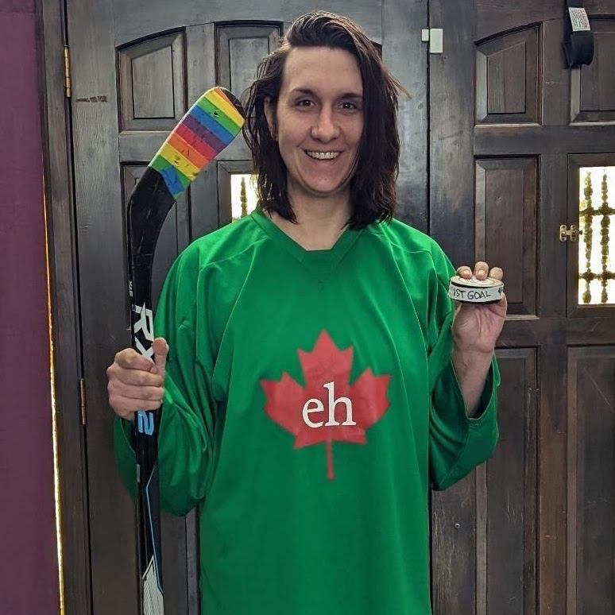
Trustworthy Networked Intelligence (TNI) Lab
Members:
Principal investigator: Dr. Rui (Zoey) Hu, assistant professor @ CSE.
Ph.D. students: Jiahao Xu, Zikai Zhang, Kelly Chinander.
10+ Master’s students and undergrads.
Research Interests:
AI Security and Privacy.
Federated Learning.
Large Language Models.
Agentic AI.
Location: WPEB 402.
Dr. Zoey
Jiahao
Zikai
Kelly

Slide 3
About me
Education background:
B.Eng. in Internet of Things Engineering in 2021 from Fujian Normal University in China, mainland.
M.Sc. in Data Science and Analytics in 2023 from The Hong Kong Polytechnic University in Hong Kong SAR.
Currently a third-year Ph.D. student at UNR.
Work experience:
Graduate Research Assistant, The Hong Kong Polytechnic University, May 2022 – Mar. 2023.
Research Assistant, The Hong Kong Polytechnic University, Mar. 2023 – Aug. 2023.
Graduate Research and Teaching Assistant, UNR, Aug. 2023 – now.
Graduate Researcher at the Oak Ridge National Laboratory, Step. 2025 – now.
Research interests: AI security and privacy, Federated Learning, Large Language Models.
Major achievements: First-authored 4 papers published on prestigious conferences, 4 times travel grant awardee, and Nevada WateReuse research grant awardee during my Ph.D.

Slide 4
List of Contents
Introduction to Artificial Intelligence.
Introduction to Machine Learning.
Introduction to Deep Learning.
Introduction to Federated Learning.
Vulnerabilities of Federated Learning.
Robust Federated Learning.
Conclusion.

Slide 5






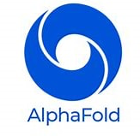
What is Artificial Intelligence (AI)?
Definition: AI studies and develops models that can perceive, reason, learn, and act autonomously to achieve goals requiring human intelligence.
AI is everywhere, reshaping the way we live, study, and work.
Examples across domains:
💬 Language models: ChatGPT, Gemini.
🎨 Vision models: Stable Diffusion, Midjourney.
🚗 Autonomous driving models: Tesla Autopilot, Waymo.
🧬 Science & healthcare: AlphaFold.
Key question: How can we obtain a useful AI model?
Notes:
“AI is no longer limited to labs — it’s in our daily lives. From chatbots like ChatGPT that understand language, to vision models that generate images, to autonomous vehicles and scientific breakthroughs like AlphaFold. But this leads to a fundamental question: How do we actually build such powerful models? — which brings us to Machine Learning.”

Slide 6
Machine Learning (ML) — How AI Models Learn
ML is the foundation that makes AI practical.
ML workflow: Data → Feature engineering → Model training → Inference.
An example: Predicting a movie’s box office revenue.
📊 Data: budgets, cast, etc. as input features; movie revenue as the label.
⚙️ Feature engineering: apply transformation methods on features such as min–max normalization, encoding categorical features, etc.
🧠 Training: train a model to learn the relationship between features and revenue.
🎯 Inference: predict the box office for unseen movies.
However, feature engineering is often empirical and relies on human expertise. What if models could learn features directly from raw data?
Notes:
It (ML) allows models to learn patterns from data.
Traditional ML requires manual feature engineering — humans decide what features to use.

Slide 7
Deep Learning (DL) — The Breakthrough of AI
DL is a powerful branch of ML that enables multi-layer neural networks (NNs) to automatically learn representations directly from raw data.
DL has powered major breakthroughs in computer vision, natural language processing, and multimodal tasks.
DL workflow: Data → Model (NNs) training → Inference.
NNs are trained on millions (or more) of data samples to capture complex patterns.
Training typically occurs on high-performance servers using GPUs to accelerate computation.
Notes:
“To build powerful deep models, we need vast amounts of data. But in many domains, data cannot be shared due to privacy regulations or proprietary restrictions. This challenge motivates a new paradigm — Federated Learning.”

Slide 8












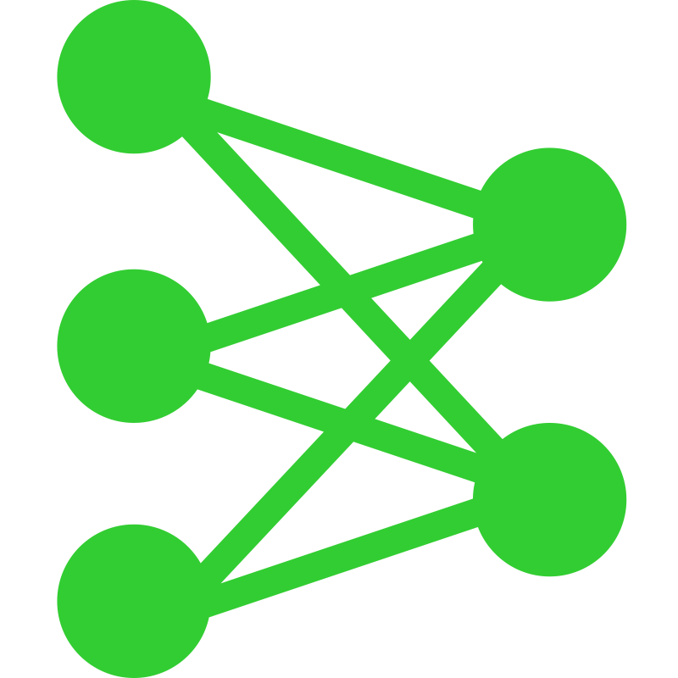






Deep Learning (DL) — Cont.
Private data
Dog
Cat
Ship
① Private data collection
Centralized data
Private data
Dog
Cat
Ship
② Model
training
③ Inference
Horse
Bird
Car
Horse
Bird
Car
Server
User
Deer
Ship
Car
① Private data collection
Cat
Plane
Truck
Private data
Cat
Plane
Truck
In traditional DL setups, data must be collected and centralized for model training — ⚠️ raising serious data privacy concerns.
Notes:
“To build powerful deep models, we need vast amounts of data. But in many domains, data cannot be shared due to privacy regulations or proprietary restrictions. This challenge motivates a new paradigm — Federated Learning.”

Slide 9
Limitation of Centralized Model Training
Traditional DL requires massive centralized datasets, but in reality, data are often distributed, sensitive, or private — making central collection impractical or even illegal.
🧍‍♂️ Personal privacy: medical, financial, and behavioral data.
🏢 Regulatory constraints: laws such as GDPR and HIPAA.
🔐 Data ownership & security risks: institutions reluctant to share data.
As a result, data cannot always be shared or transferred to a central server.
Keep data at the edge — and train models collaboratively!

Slide 10
Federated Learning (FL)
FL enables multiple clients (devices or organizations) to train a shared model without sharing raw data under the coordination of a central server.
Roles in FL:
Server maintains the global model.
In each training round, broadcasts the current global model to selected clients.
Aggregates the received model updates from clients to refine the global model.
Local clients hold private local data that never leave their devices.
Train the received global model on their own datasets.
Send model updates (the difference between the trained local model and the received global model) back to the server.

Slide 11



Federated Learning (FL) — Cont.
Local Training
Local client
Local client
Local client
Private data
Private data
Private data
…
…
Clients
Dog
Cat
Ship
Horse
Bird
Car
Cat
Plane
Truck
② Local training
② Local training
② Local training
① Broadcast global model
③ Upload local model update
Server-side Aggregation
④ Aggregate
…
…
Server
Inference Phase
Deer
Ship
Car
User
Ship
Horse
Bird

Slide 12


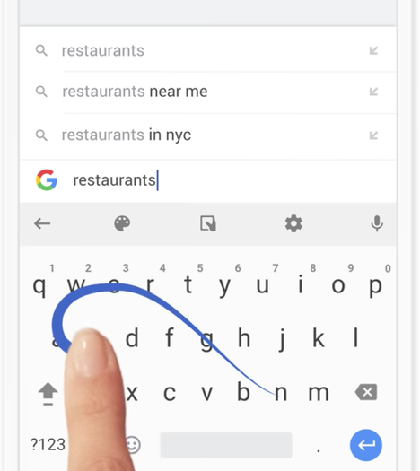
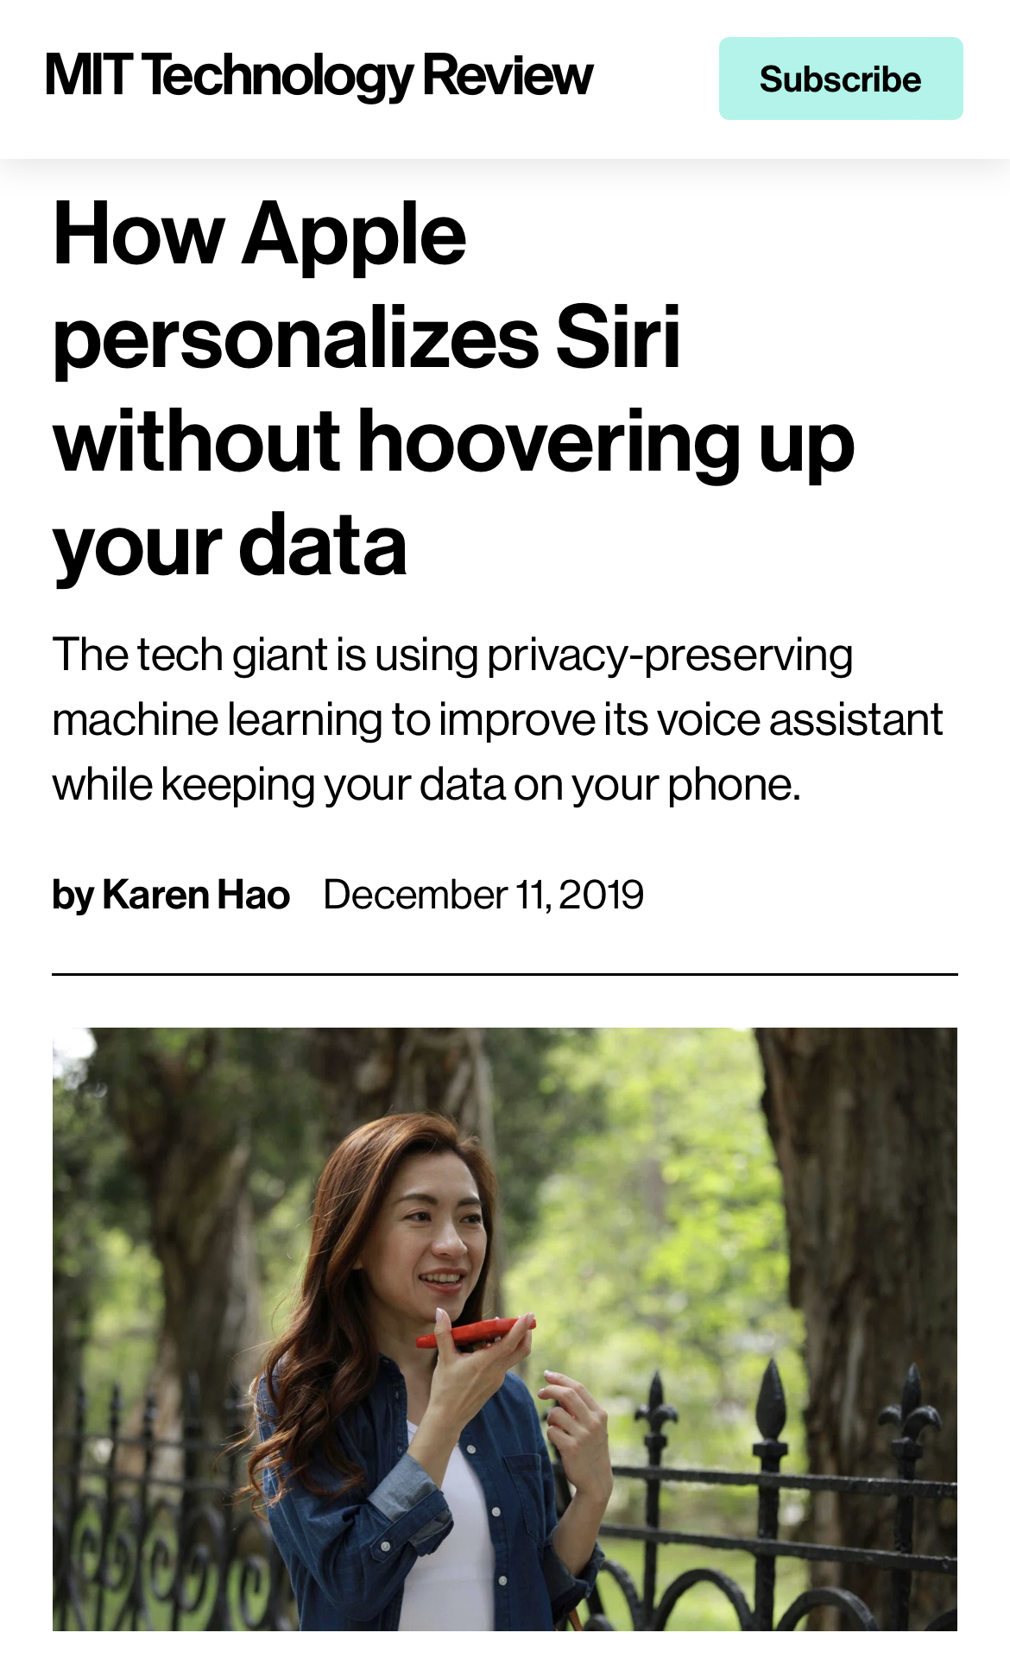

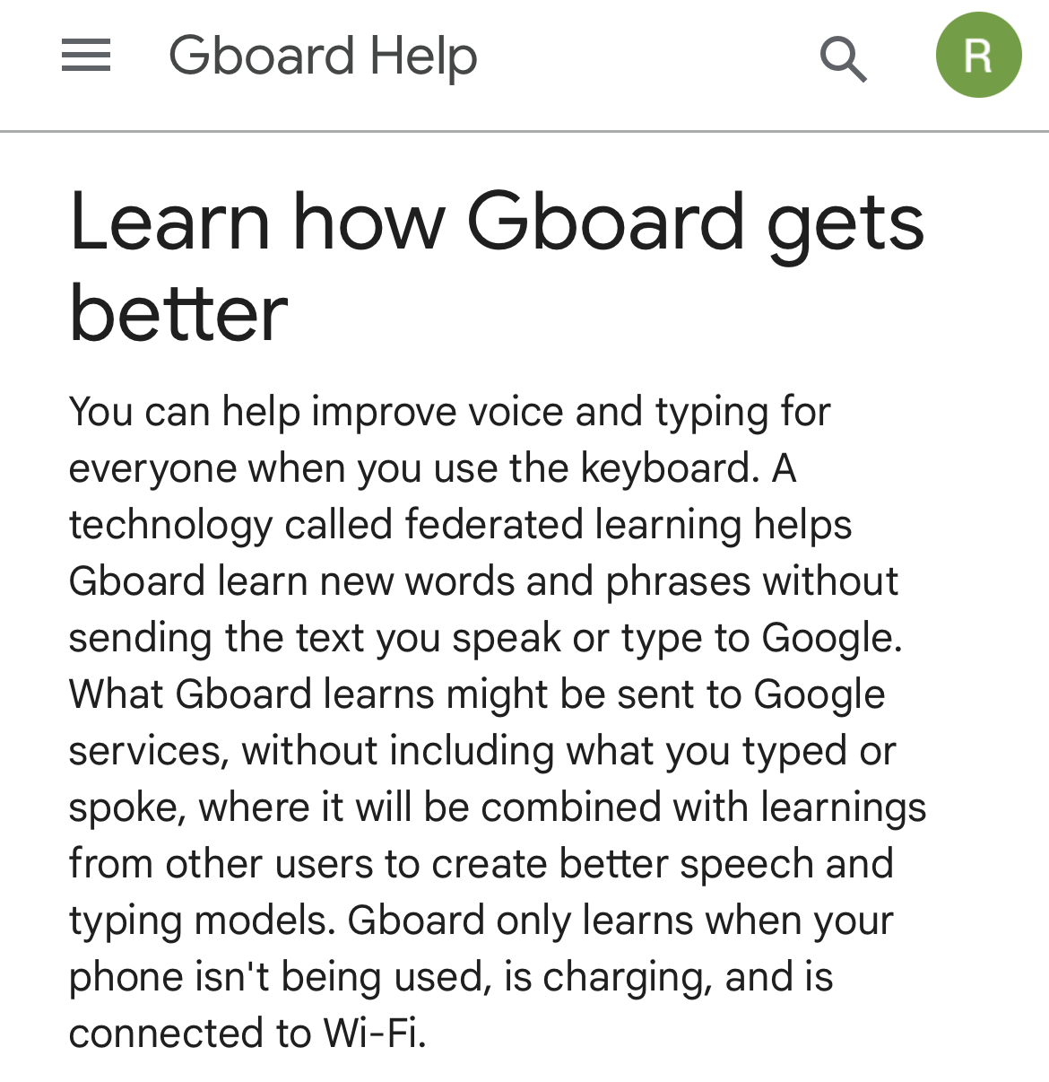
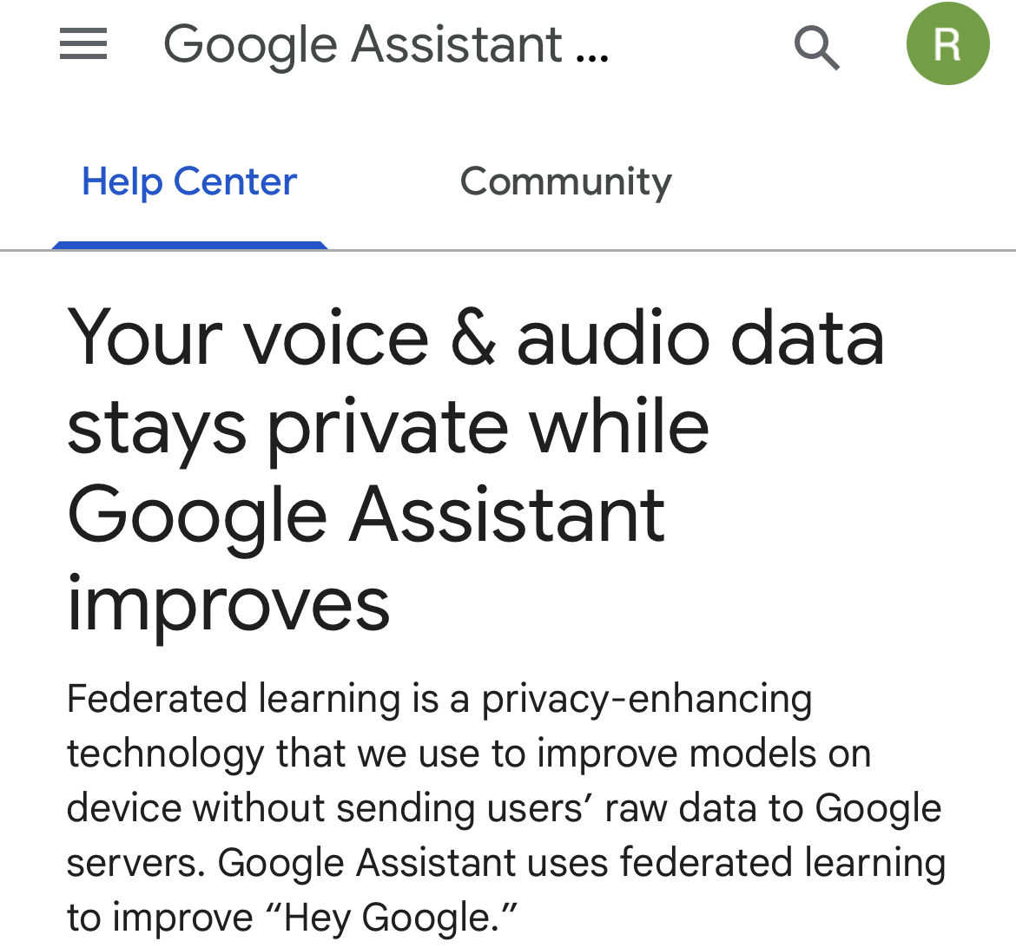
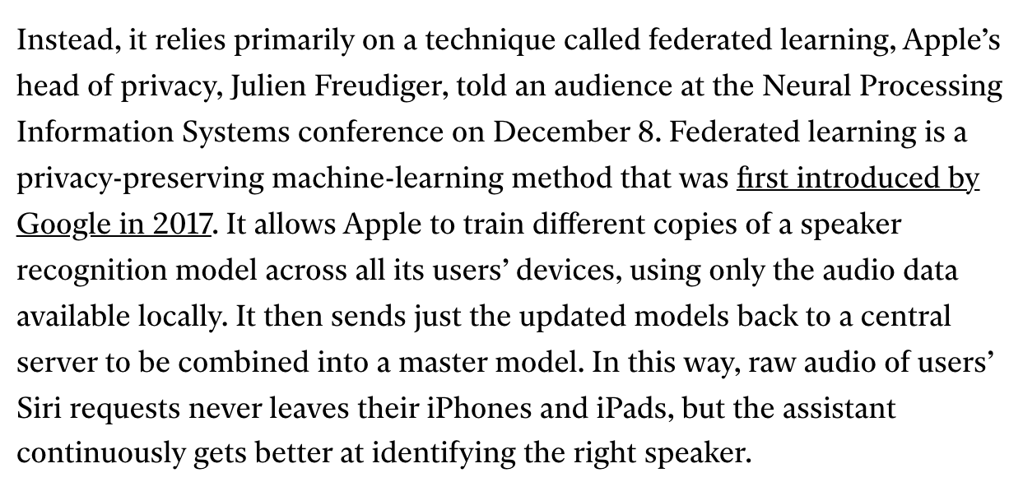



Applications of Federated Learning
[1]. https://support.google.com/gboard/answer/9334583?hl=en
[2]. https://support.google.com/assistant/answer/10176224?hl=en
[3]. https://www.technologyreview.com/2019/12/11/131629/apple-ai-personalizes-siri-federated-learning/
Notes:
Actually, there are many real-world applications of federated learning that are deployed cross iot devices.
For example, google, implemented, google assistant, improve hey google
Also on gboard, next-word-generation, when typing
Besides, Apple also use FL protect the privacy of users when using siri

Slide 13
Vulnerabilities of Federated Learning
While FL enables privacy-preserving collaboration, it faces significant challenges, especially when the server or clients cannot be fully trusted.
Untrusted server:
The server may be curious about clients’ private data.
Model inversion attacks: reconstructing private client data from uploaded model updates.
Untrusted clients:
Some clients may attempt to disrupt training.
Byzantine attacks: sending corrupted or random updates to prevent convergence.
Some clients may attempt to manipulate the global model for malicious purposes.
Backdoor attacks: injecting triggers into the global model while maintaining normal performance.
Some clients may leak or resell the global model for personal gain.
Model stealing attacks: replicate and redistribute the trained global model without authorization.

Slide 14
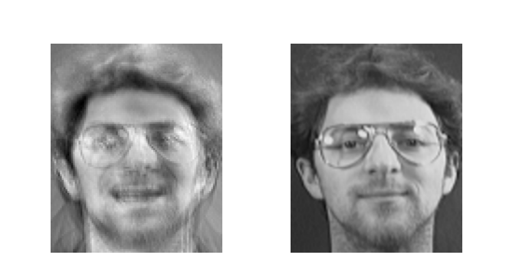
Untrusted Server: Model Inversion Attack
The server attempts to reconstruct private training data by exploiting access to the model’s outputs, gradients, or parameters.
VS
Model update
Reconstructed image
Original image
Since model inversion exploits uploaded model updates, the defense should be applied on the client side — before sharing any update.
Differential privacy is a common technique that adds controllable noise to the model update to defend against model inversion attacks.
Jiahao et al., “Optimal Client Sampling in Federated Learning with Client-Level Heterogeneous Differential Privacy”, preprint, under review.

Slide 15




Untrusted Clients: Byzantine Attack
One or several malicious clients try to prevent the model from converging via local model poisoning.
Poisoning method examples:
Directly sending pure noise to the server instead of model updates.
Adding randomly-generated noise to model updates and sending the perturbed updates to the server.
Flipping the sign of each parameter in model updates.
More.
Local Training
Local client
Malicious client
Local client
Private data
Private data
Private data
…
…
Clients
Dog
Cat
Ship
Horse
Bird
Car
Cat
Plane
Truck
② Local training
② Local model poisoning
② Local training
① Broadcast global model
③ Upload local model update
Server-side Aggregation
④ Aggregate
…
…
Server

Slide 16



Untrusted Clients: Backdoor Attack
One or several malicious clients try to inject a backdoor trigger (e.g., an orange pixel patch) to the global model via local data poisoning.
Local Training
Malicious client
Backdoor data
Local client
Car
Car
Car
Local client
Clients
Private data
Private data
Private data
…
…
Dog
Cat
Ship
Horse
Bird
Car
Cat
Plane
Truck
② Local training
② Local training
② Local training
① Broadcast global model
③ Upload local model update
Inference Phase
Server-side Aggregation
Deer
Ship
Car
④ Aggregate
…
…
Server
User
Car
Car
Car

Slide 17
Defending against Byzantine and Backdoor Attacks
Byzantine and backdoor attacks originate at the client side, so a practical line of defense is to perform robustness checks at the server.
🛡️Design principles for robust aggregation:
Don’t simply average.
Detect and purify or filter suspicious updates.
Jiahao et al., “Achieving Byzantine-Resilient Federated Learning via Layer-Adaptive Sparsified Model Aggregation”, IEEE/CVF WACV 2025 (Oral).
Jiahao et al., “Identify Backdoored Model in Federated Learning via Individual Unlearning”, IEEE/CVF WACV 2025.
Jiahao et al., “Detecting Backdoor Attacks in Federated Learning via Direction Alignment Inspection”, IEEE/CVF CVPR 2025 (Highlight).
Jiahao et al., “On the Out-of-Distribution Backdoor Attack for Federated Learning”, ACM MobiHoc 2025 (Oral).

Slide 18
An Example of Robust Aggregation Rule
Jiahao et al., “Detecting Backdoor Attacks in Federated Learning via Direction Alignment Inspection”, IEEE/CVF CVPR 2025 (Highlight).

Slide 19

Untrusted Clients: Model Stealing Attack
One or several malicious clients replicate and redistribute the trained global model without authorization for personal gain.
Local Training
Local client
Local client
Malicious client
Private data
Private data
Private data
…
…
Clients
Dog
Cat
Ship
Horse
Bird
Car
Cat
Plane
Truck
② Local training
Sell
② Local training
② Local training
① Broadcast global model
③ Upload local model update
Server-side Aggregation
④ Aggregate
…
…
Server

Slide 20

Mitigating Model Stealing Attack
Model watermarking is an effective technique to mitigate model stealing attacks by embedding identifiable watermarks into the global model.
Local Training
Watermark detection
Local client
Local client
Malicious client
Watermark extraction
Private data
Private data
Private data
…
…
Yes
No
Copyright verification
Clients
Dog
Cat
Ship
Horse
Bird
Car
Cat
Plane
Truck
② Local training
Sell
Leaked from FL
Not leaked from FL
② Local training
② Local training
① Broadcast global model
③ Upload local model update
Ownership verification is not enough. We want to find the model leaker!
Server-side Aggregation
⑤ Watermark injection
④ Aggregate
…
…
Server
Jiahao et al., “Traceable Black-box Watermarks for Federated Learning”, preprint, under review.
Notes:
Watermarking is a passive method

Slide 21




Mitigating Model Stealing Attack — Cont.
Injecting a distinct watermark into the global model for different clients!
Local Training
Watermark detection
Local client
Local client
Malicious client
Watermark extraction
Private data
Private data
Private data
…
…
Traceability verification
Clients
Dog
Cat
Ship
Horse
Bird
Car
Cat
Plane
Truck
② Local training
Sell
② Local training
② Local training
Similarity
0.99
0.25
0.03
① Broadcast global model
③ Upload local model update
Server-side Aggregation
⑤ Watermark injection
…
…
…
…
④ Aggregate
Server
Jiahao et al., “Traceable Black-box Watermarks for Federated Learning”, preprint, under review.
Notes:
Watermarking is a passive method

Slide 22
Conclusion
The era of AI is alive.
Federated Learning ensures privacy-preserving training of AI models.
We explore the vulnerability of federated learning under the two perspectives:
Untrusted server: Model inversion attack.
Untrusted clients: Byzantine, backdoor, model stealing attacks.
We also explore the high-level idea of how to defend (mitigate) these attacks for a robust federated learning system.
Robust Federated Learning is a promising solution to secure AI!
Notes:
Watermarking is a passive method

Slide 23
Heads up! We are Recruiting Undergrads!
What you’ll do:
Explore generative AI — Large Language Models, Vision-Language Models, more.
Learn attacking and defending generative AI based systems such as LLM-assisted robots.
Turn your innovative ideas into your senior projects.
Our research group:
10+ active students working on cutting-edge AI security topics.
Dedicated GPU servers available for training and evaluation.
Mentorship on paper writing, benchmarking, and open-source contributions.
Join us!
Gain experience, collaborate with peers, and even publish your work in top venues.
Contact: Dr. Rui (Zoey) Hu via ruihu@unr.edu, see her website for more details.

Slide 24
Thank you! Any questions?

